Slide 1



Building a Community of Cyberinfrastructure Facilitators
Henry Neeman, University of Oklahoma
Director, OU Supercomputing Center for Education & Research (OSCER)
Assistant Vice President, Information Technology – Research Strategy Advisor
Associate Professor, Gallogly College of Engineering
Adjunct Associate Professor, School of Computer Science
URSSI Conference 2018, Tuesday October 23 2018

Slide 2
Outline
Campus Champions
Virtual Residency
Campus Research Computing Consortium
Most of the material in this talk is courtesy of Dana Brunson and Dan Voss.

Slide 3
Campus Champions

Slide 4
Campus Champions: Breadth
500+ champions from 260+ US academic and research-focused institutions help their local researchers to use CI, especially large scale and advanced computing.
Every US state, every US EPSCoR jurisdiction
FREE to join with letter of collaboration.
Funded via XSEDE project (but no longer XSEDE-focused).
All flavors of campus research computing professionals (directors, sysadmins, user support, trainers, coordinators, research software engineers, etc.).
Plus new “affiliates” – from organizations that serve the larger community (XSEDE, Internet2, Globus, BDHubs, national HPC centers, etc).
https://www.xsede.org/campus-champions

Slide 5


Campus Champions: Nationwide
Research computing community facilitating computing- and data-intensive research and education
Champions help their local researchers and educators find and use the advanced digital services that best meet their needs; and,
Champions share CI challenges and solutions
With support from:
https://www.xsede.org/web/site/community-engagement/campus-champions

Slide 6
Campus Champions Growth

Slide 7
Synchronous Champions
Monthly Discussions
1st Tuesday: Champion Leadership team
2nd Tuesday: Community Chat
3rd Tuesday: All-Champions Call
Guest speakers
Community updates
4th Tuesday: Sustainability working group
Other Calls and Meetings
Ad hoc special topics calls
Face-to-face meetings at regional and national conferences

Slide 8
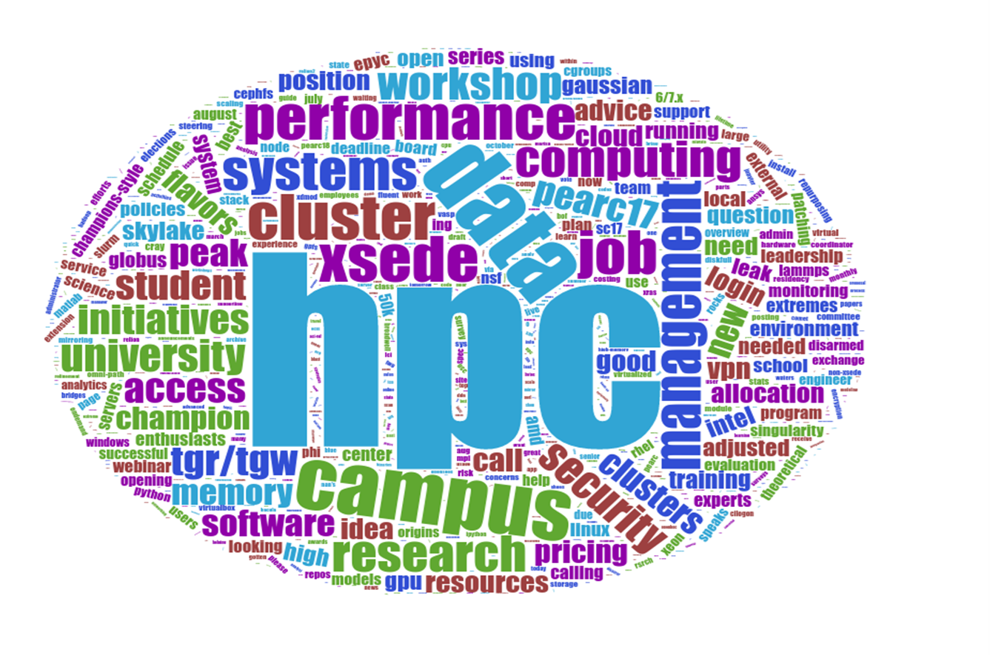
Asynchronous Champions (CY 2017)
E-mail and Slack in CY 2017
Longest Threads in CY 2017
Data Management Initiatives on YOUR Campus - TGR/TGW?
Adjusted Peak Performance for HPC clusters
OS flavors in HPC
HPC systems login access only with VPN -- good idea?
AMD EPYC and Intel Skylake Pricing Extremes
Theoretical Peak Performance
Champions-style job board?
CephFS for HPC?
Successful Scheduling
Xeon Phi on Motherboard
cgroups Memory Leak in RHEL 6/7.x
Advice needed -- Gaussian software on an HPC
sysadmin internships for undergrads?
On Evaluation of Cluster Security and Patching
Cluster Environment Monitoring
Service ticketing/tracking software
HPC Steering Committee
If you had $50K...
University risk due to using external computing resources
Cloud Costing for NSF
High School Student Looking for HPC
cloud vs local cluster stats
Memory leak in VASP (GPU)?
Origins of the Data Management Plan
New Campus Champion
Onboarding of HPC users & its challenges
How to submit an extension via XRAS [XSEDE-related]
Email list:
Distinct contributors: 274
NEW contributors: 128
# messages: 1409
# threads: 601
Slack : 14,425 total messages
11,752 direct messages
1525 in public channel

Slide 9
Virtual Residency

Slide 10
What is a CI Facilitator?
“Advanced Cyberinfrastructure Research & Education Facilitator” (ACI-REF – term coined by Miron Livny)
Work with users – researchers and educators – to help them improve their research and/or education productivity and aspirations via advanced cyberinfrastructure.
Typically, one or a few CI Facilitators have responsibility for an entire institution, or for multiple institutions.
At some institutions, CI facilitation is part time; at others, it’s full time. Some Research Computing Facilitators are:
faculty or former faculty;
postdocs or former postdocs;
research staff or former research staff;
IT professionals;
graduate or undergraduate students.

Slide 11
Virtual Residency: What?
We teach pre-service and in-service Research Computing Facilitators how to do (or do better) Research Computing Facilitation.
But then we have a hidden secret agenda ….

Slide 12
Virtual Residency: How?
Annual weeklong summer workshop (2015, 2016, 2017, 2018)
U California System has run its own targeted workshop based on our introductory workshop, in April 2017 and April 2018.
Biweekly conference calls
Annual meeting at the SC supercomputing conference
2017-18: Grant Proposal Writing Apprenticeship (now being repeated, because the grant proposal didn’t get funded)
2018: Paper Writing Apprenticeship (just started in Oct 2018)
Before the Virtual Residency, no one had ever been dumb enough to try to teach this stuff.

Slide 13
Virtual Residency: Why?
CI Facilitators have strong experience within their discipline (often non-CS).
Most CI Facilitators and CI Engineers haven’t been faculty.
Sometimes little or no research experience (especially for IT staff who have an enterprise IT background).
Even if strong research background, typically little or no experience with research outside their own discipline.
When we started the Virtual Residency in 2015, there were no local, regional or national programs to teach people how to be a Research Computing Facilitator.
In the olden days, you could take your time learning how to do this – but not anymore ….

Slide 14
Virtual Residency: Who?
2015-2018: We’ve served 466 people from 235 institutions in all 50 US states and 2 US territories, plus 6 other countries, including:
34 (14%) of VR institutions are Minority Serving Institutions;
48 (20%) of VR institutions are non-PhD-granting institutions;
72 (31%) of VR institutions are in 24 (92%) of 26 EPSCoR jurisdictions;
169 (72%) of VR institutions are Campus Champion institutions (64% of Campus Champion institutions).
This is for ALL Virtual Residency activities, including:
workshops (including mini-workshops by/for U California);
Virtual Residency conference calls;
the Grant Proposal Writing and Paper Writing Apprenticeships.

Slide 15
Why is Helping Researchers Hard?
Ubiquity: Within any discipline, a greater proportion of researchers do computing-intensive and/or data-intensive research.
Applicability: More disciplines do computing-intensive and/or data-intensive research.
System Complexity: The storage hierarchy is getting deeper (flash, non-volatile RAM etc), and parallelism is getting more hybrid (GPUs etc).
Conceptual Distance: The mental gap from handheld computing to command line/Linux/batch/remote/shared.
But we only have one hour before they lose interest!

Slide 16
More Institutions Have On-Premise CI
The fraction of national universities that have on-premise research computing resources (US News rankings):
49 of the top 50 institutions;
96 of the top 100;
136 of the top 150 (91%);
167 of the top 200 (84%).

Slide 17
More Institutions Have Virtual Residents
The fraction of national universities that have participated in, or are registered to participate in, the Virtual Residency (US News rankings):
7 of the top 10 institutions (70%);
18 of the top 25 (72%);
36 of the top 50 (72%);
54 of the top 75 (72%);
73 of the top 100 (73%);
106 of the top 150 (71%);
126 of the top 200 (63%);
162 of the top 300 (54%).

Slide 18
What Aren’t We Trying to Do?
We AREN’T trying to cover a lot of technical content.
People can learn that from other sources.
Instead, the goal is to teach the PROFESSION of CI facilitation.

Slide 19
What’s Our Hidden Agenda?
The real goal is to prepare for an upcoming transition to:
more need for this kind of skilled workforce, but
fewer people who know how to do it, with
no mechanism to prepare a sufficiently large cohort.
Some of the participants already knew how to do this.
But it took a very long time to learn on their own.
To keep up with demand, the community needs us to streamline the process so that new facilitators can become fully productive quickly.
These are the CI leaders of tomorrow.

Slide 20
Campus Research Computing Consortium (CaRCC)

Slide 21
Campus Research Computing Consortium
NSF funded Research Coordination Network grant with 28 collaborating institutions
https://www.nsf.gov/awardsearch/showAward?AWD_ID=1620695
Surveyed community to understand challenges and values.
Focused on CI professionalization.
Aim is to develop ways for more to join.

Slide 22
The Four Facings
Researcher-facing: e.g., CI Facilitators
Systems-facing: e.g., HPC sysadmins, Research Network Engineers
Software/data-facing: e.g., Research Software Engineers
Sponsor/stakeholder-facing: e.g., campus CI leaders

Slide 23
Thanks for your attention! Questions? champion-info@xsede.org

